Slide 1
Uncertainty Quantification method on Lorenz 96 model
Jongyoon Sohn
Advised by Professor John Harlim

Slide 2
Overview
Uncertainty Quantification(UQ)
The process of determining & analyzing outcomes of input uncertainties
Reducing uncertainties in both computational and real world application
How to Approach
Polynomial Chaos Expansion(Orthogonal polynomial basis)
Stochastic Galerkin method(ex: Lorenz 96)
Monte Carlo method

Slide 3
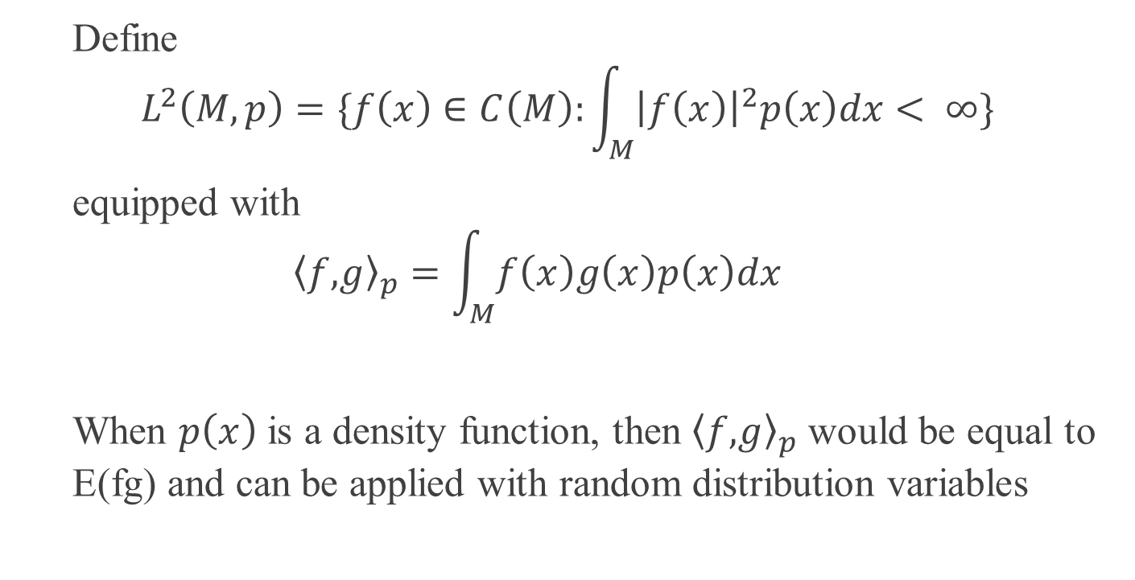
Hilbert Space
Define
$$L^{2}\left(M,p\right)=\{f\left(x\right)∈C\left(M\right):\int_{M}^{ }{{\left|f\left(x\right)\right|}^{2}p\left(x\right)dx< ∞}\}$$
equipped with
$$\left\langle f,\right.{\left.g\right\rangle }_{p}=\int_{M}^{ }{f\left(x\right)g\left(x\right)p\left(x\right)dx}$$
When $p\left(x\right)$ is a density function, then $\left\langle f,\right.{\left.g\right\rangle }_{p}$ would be equal to E(fg) and can be applied with random distribution variables

Slide 4
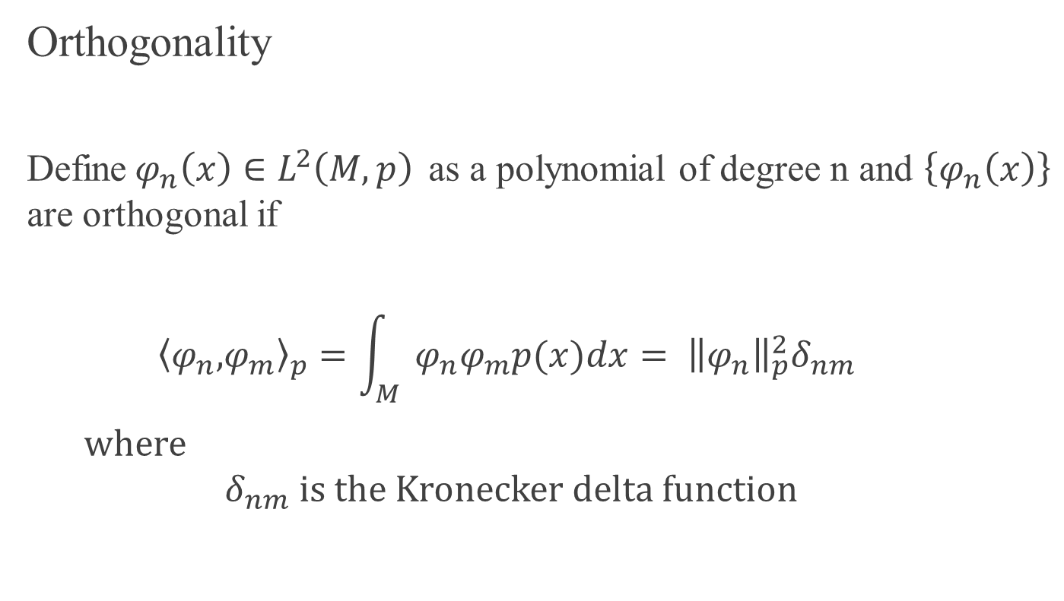
Hilbert Space Cont.
Orthogonality
Define$φ_{n}\left(x\right)∈L^{2}\left(M,p\right)$ as a polynomial of degree n and $\left\{φ_{n}\left(x\right)\right\}$ are orthogonal if
$$\left\langle φ_{n},\right.{\left.φ_{m}\right\rangle }_{p}=\int_{M}{φ_{n}φ_{m}p(x)dx}= {\left\|φ_{n}\right\|}_{p}^{2}δ_{nm}$$
where
$$δ_{nm} is the Kronecker delta function$$

Slide 5
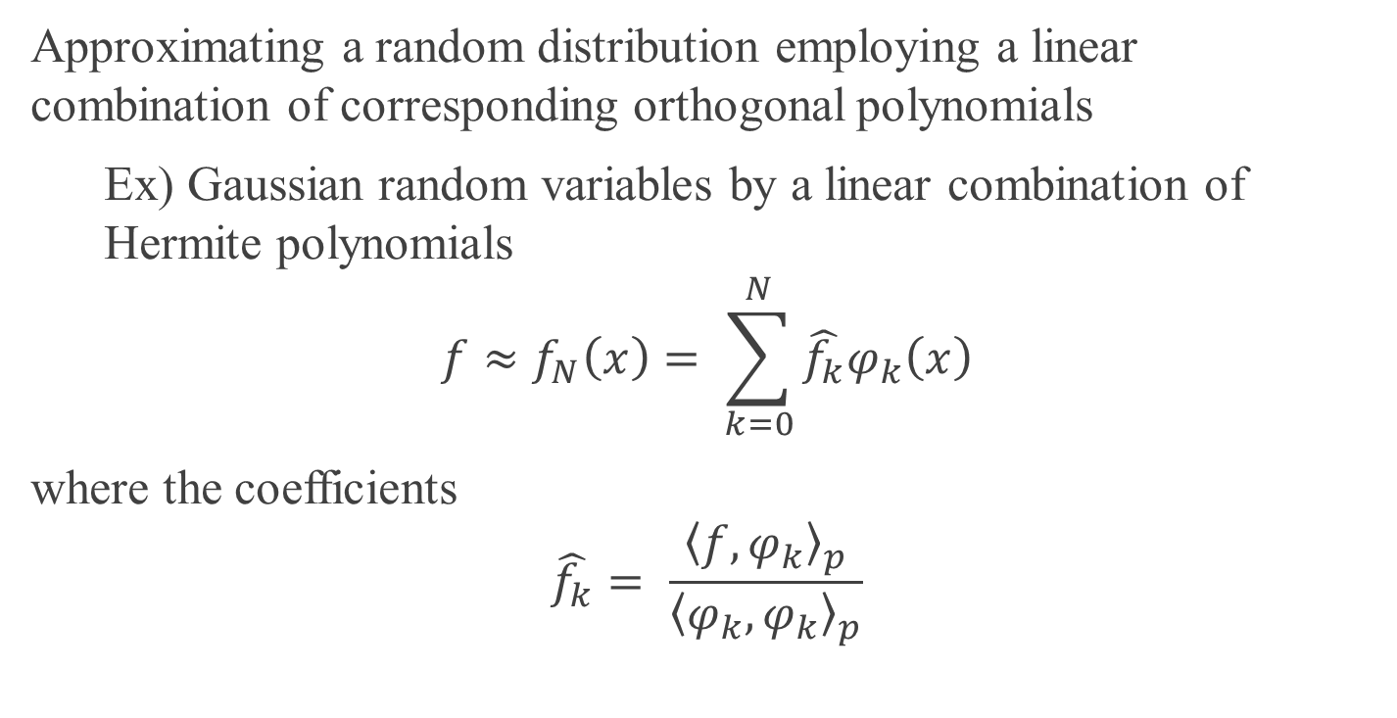
Polynomial Chaos Expansion(PCE)
Approximating a random distribution employing a linear combination of corresponding orthogonal polynomials
Ex) Gaussian random variables by a linear combination of Hermite polynomials
$${f≈f}_{N}\left(x\right)= \sum_{k=0}^{N}{\hat{f_{k}}φ_{k}\left(x\right)}$$
where the coefficients
$$\hat{f_{k}}= \frac{{\left\langle f,φ_{k}\right\rangle }_{p}}{{\left\langle φ_{k},φ_{k}\right\rangle }_{p}}$$

Slide 6
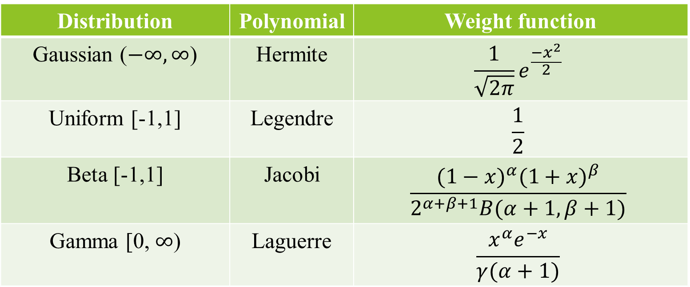
PCE Cont.
Distribution | Polynomial | Weight function
Gaussian ($−∞,∞$) | Hermite | $${\frac{1}{\sqrt{2π}}e}^{\frac{{−x}^{2}}{2}}$$
Uniform [-1,1] | Legendre | $$\frac{1}{2}$$
Beta [-1,1] | Jacobi | $$\frac{{(1−x)}^{α}{(1+x)}^{β}}{2^{α+β+1}B(α+1,β+1)}$$
Gamma [0, $∞$) | Laguerre | $$\frac{x^{α}e^{−x}}{γ(α+1)}$$
Table 1: Random variables with corresponding orthogonal polynomials

Slide 7
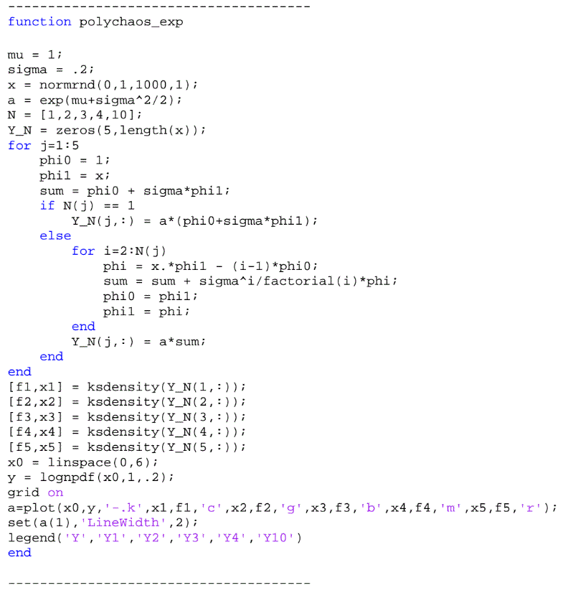

Example
Let’s approximate a lognormal distribution $Y=f\left(X\right)=e^{μ+σX} where X\sim N(0,1)$
Using PCE,
$$Y≈Y_{N}\left(X\right)=e^{μ+\frac{σ^{2}}{2}}\sum_{k=0}^{N}{\frac{σ^{k}}{k!}φ_{k}(X)}$$

Slide 8
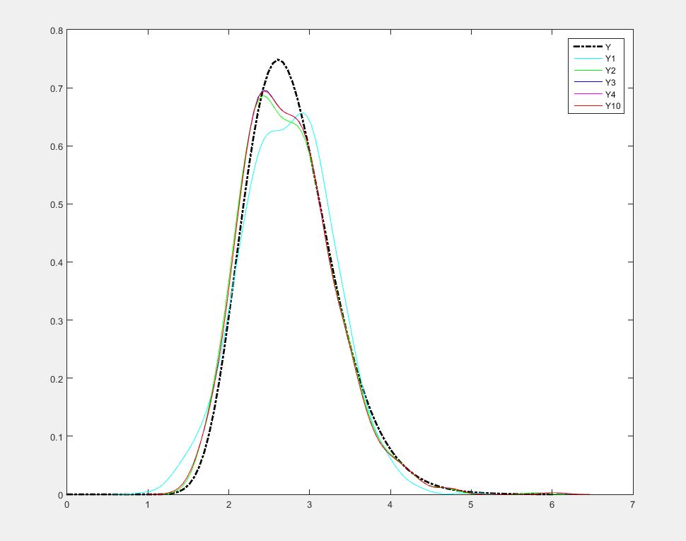
Example cont.

Slide 9
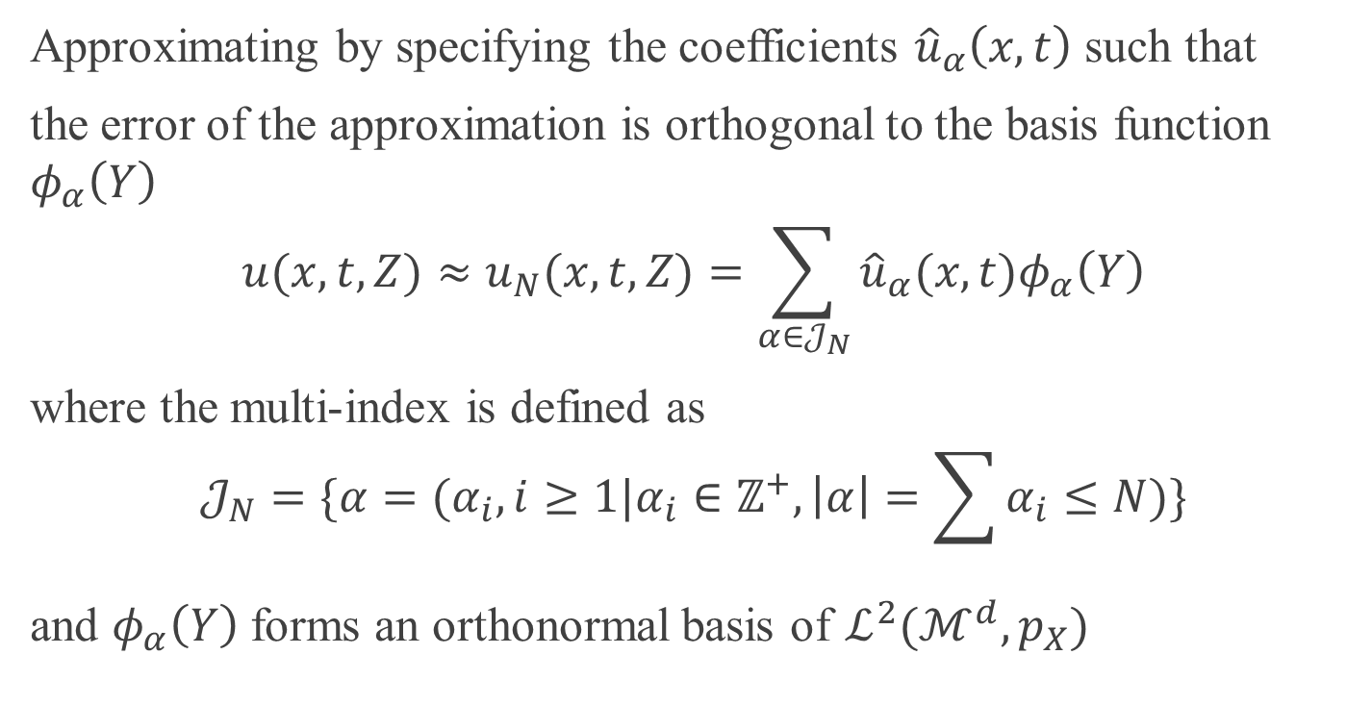
Galerkin method
Approximating by specifying the coefficients ${\hat{u}}_{α}\left(x,t\right)$ such that
the error of the approximation is orthogonal to the basis function $φ_{α}\left(Y\right)$
$$u(x,t,Z)≈u_{N}(x,t,Z)=\sum_{α∈𝒥_{N}}{{\hat{u}}_{α}(x,t)φ_{α}\left(Y\right)}$$
where the multi-index is defined as
$$𝒥_{N}=\{α=(α_{i},i≥1|α_{i}∈ℤ^{+},\left|α\right|=\sum{α_{i}≤N)}\}$$
and $φ_{α}\left(Y\right)$ forms an orthonormal basis of $ℒ^{2}(ℳ^{d},p_{X})$

Slide 10
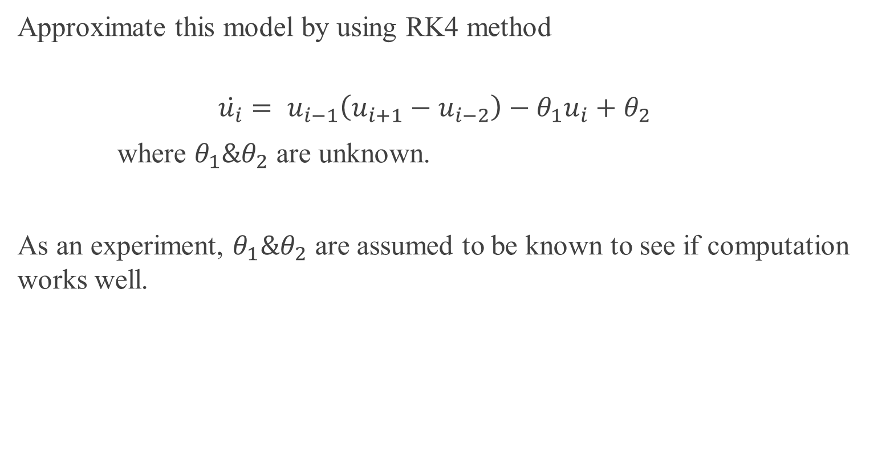
Lorenz 96 model
Approximate this model by using RK4 method
$$\dot{u_{i}}= u_{i−1}\left(u_{i+1}−u_{i−2}\right)−θ_{1}u_{i}+θ_{2}$$
where $θ_{1}\&θ_{2}$ are unknown.
As an experiment, $θ_{1}\&θ_{2}$ are assumed to be known to see if computation works well.

Slide 11
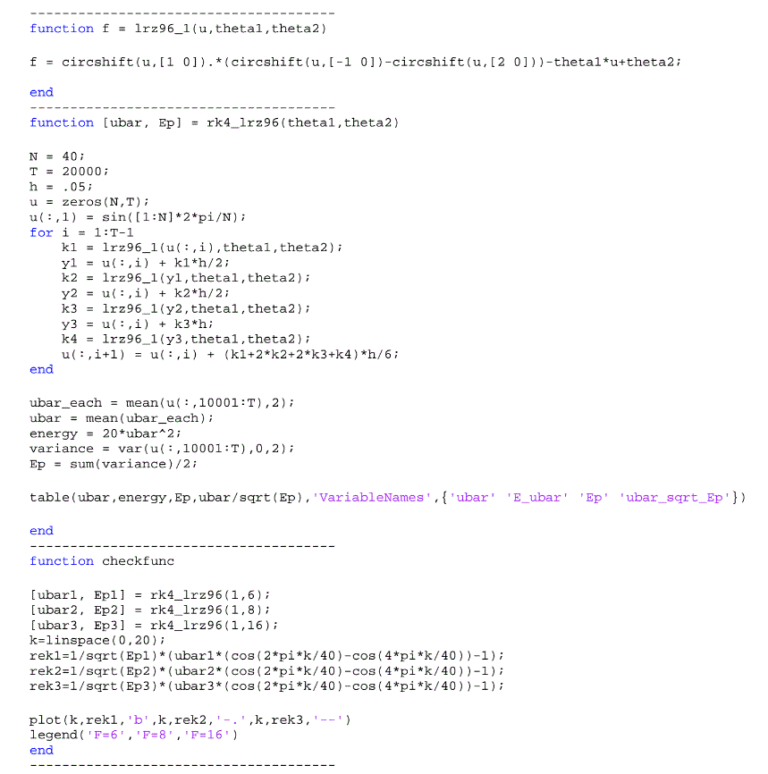

Lorenz Model Cont.
Assume that
$$θ_{1}=1 and$$
$$θ_{2}=6, θ_{2}=8,θ_{2}=16$$

Slide 12
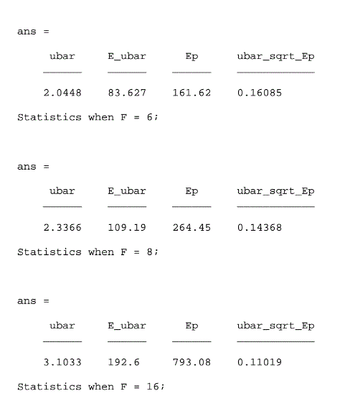
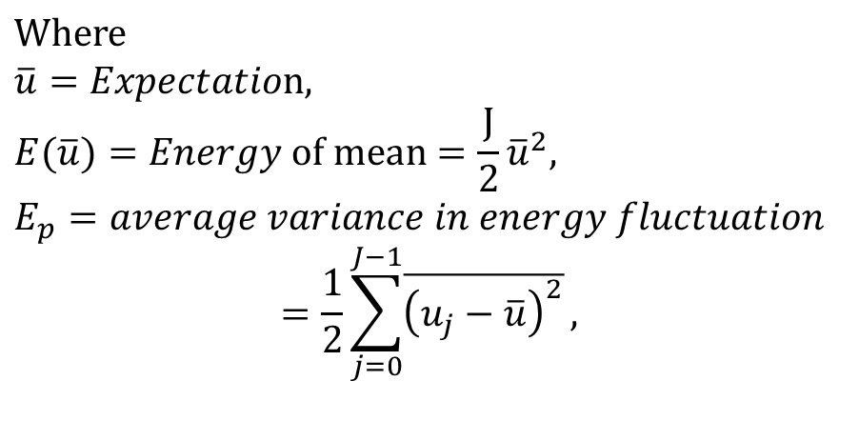
Lorenz Model Cont.
$$Where$$
$$\overline{u}=Expectation,$$
$$E(\overline{u})=Energy of mean=\frac{J}{2}{\overline{u}}^{2},$$
$$E_{p}=average variance in energy fluctuation$$
$$=\frac{1}{2}\sum_{j=0}^{J−1}{\overline{{\left(u_{j}−\overline{u}\right)}^{2}}},$$

Slide 13
Future objectives
Solve the ODE using Galerkin method by randomizing unknowns as some random distribution variables and compare the solution with one by Monte Carlo method.

